Slide 1

National Taiwan University of Science and Technology Application of Computational Intelligence in
Engineering
Group: 2Good4A+ Final Project: N - queens
Members:
Guillermo Aguilera – M10601813
Arnold Samuel Chan – M10601803
Frederik Darwin - M10601836
汪怡銘 - M10601001
陳志瑄 - M10601007

Slide 2

Outline
N-Queen Problem Introduction
Genetic Algorithm Approach
Particle Swarm Optimization Approach
Simulated Annealing Approach
Comparison
Conclusion

Slide 3

N-Queen Problem
The rule is simple, place a queen on each column (or each row) so that each of them not hit another queen in one move, even with diagonal moves.
Constraints:
We have exactly N queens positioned on the board.
There is exactly one queen in every row.
There is exactly one queen in every column.
Any diagonal we could draw over the board should hit, at most, one queen.

Slide 4

Objective function:
F(x) = penalty
penalty = in the solution we cannot have any number repeated twice.
To calculate the penalty, we use this formula:
C_{r}^{n} = n!/r!(n-r)!
And all possible solutions are:
When we have just one queen in one diagonal (this one is the most desired solution): P₁= 0
When we have 2 queens in the same diagonal:
P₂= C₂²= (2*1)/2 = 1
When we have 3 queens in the same diagonal:
P₃= C₂³= (3*2)/2 = 3
When we have 4 queens in the same diagonal:
P₄= C₂⁴= (4*3)/2 = 6
X
 |  | X
 | X
 |  |  | X
 | 0 | 1 | 2 | 3
0 | 0 | 1 | 2 | 3
1 | 1 | 2 | 3 | 4
2 | 2 | 3 | 4 | 5
3 | 3 | 4 | 5 | 6
 | 3 | 2 | 1 | 0
0 | 3 | 2 | 1 | 0
1 | 4 | 3 | 2 | 1
2 | 5 | 4 | 3 | 2
3 | 6 | 5 | 4 | 3
0
 |  | 3
 | 3
 |  |  | 6
3
 |  | 2
 | 4
 |  |  | 3

Slide 5
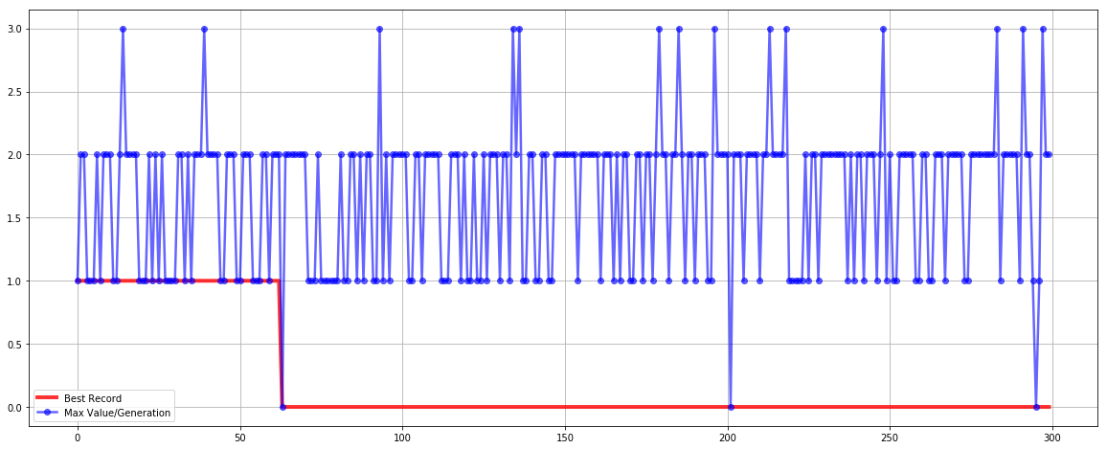
GA Approach - 1
Iterations : 300
Population : 100
Crossover : PMX(0.3~0.8)
Mutation : Random Swap
Selection : Roulette Wheel
Evaluation : Count penalty

Slide 6
GA Approach - 2
Permutation with multiple solutions may be disturbing
Crossover and mutation won’t improve results
Reducing number of queens may reduce iterations needed

Slide 7

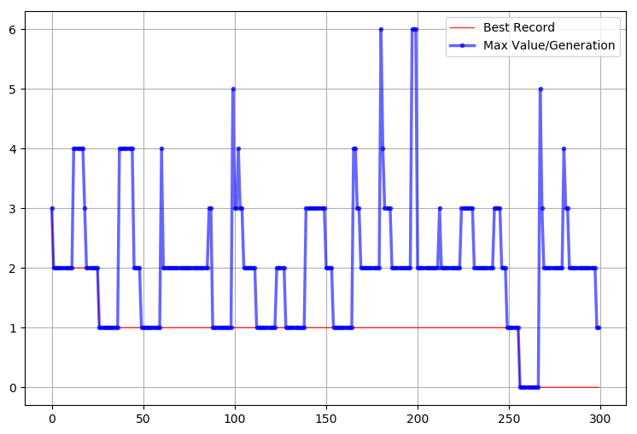
PSO Approach - 1
Iterations : 300
Swarm Size : 100
Features : Craziness

Slide 8
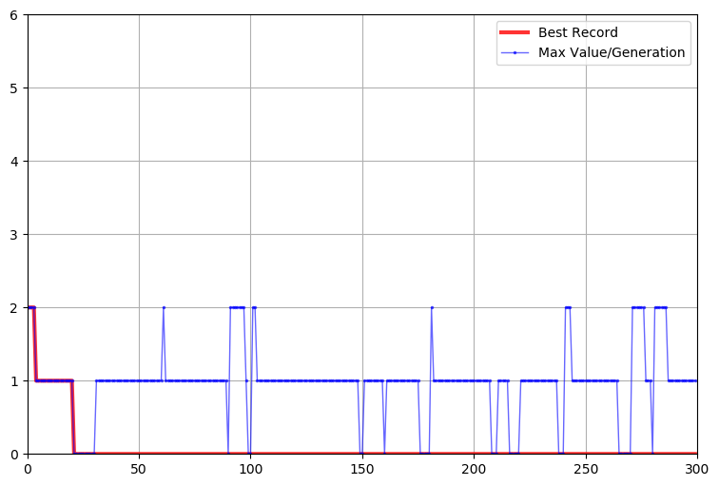
PSO Approach -2
Reducing Size of Queen significantly reduce the iteration needed

Slide 9
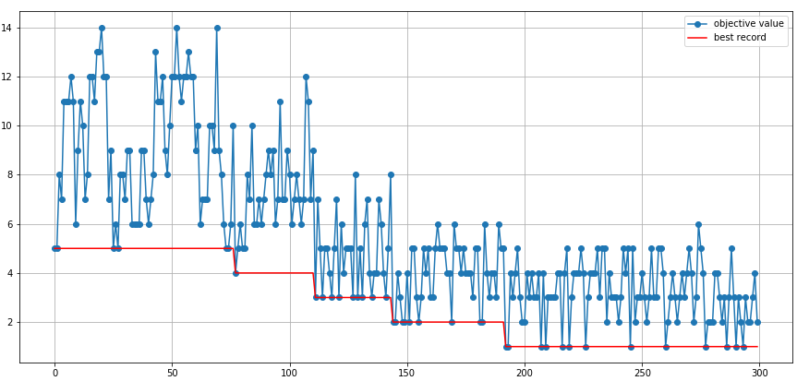
SA Approach - 1
Evaluation : Count penalty
Cooling Schedule : Geometrical (with a = 0.95)
Initial Temperature : 300
Number of Iterations (n_iter = 1): 300

Slide 10
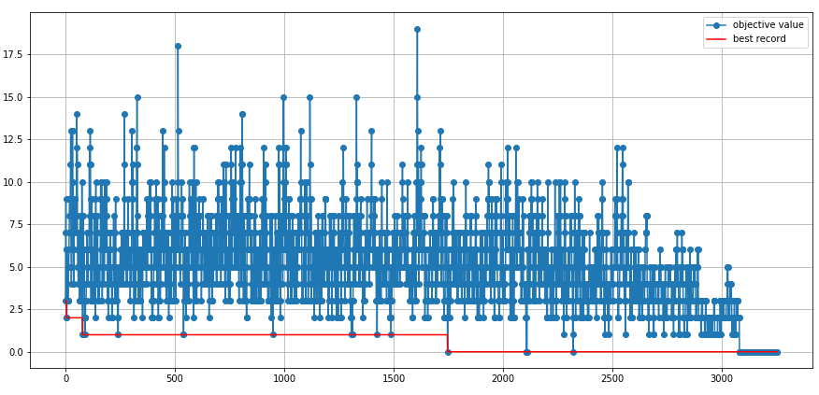
SA Approach - 2
Create linearly increasing iteration each temperature changes. α=0.1 & β=10 (same as chessboard size)
Iteration done until t = 0.1
Using 10x10 chessboard
Initial temp and cooling schedule still same

Slide 11
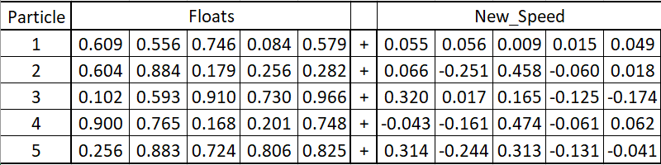
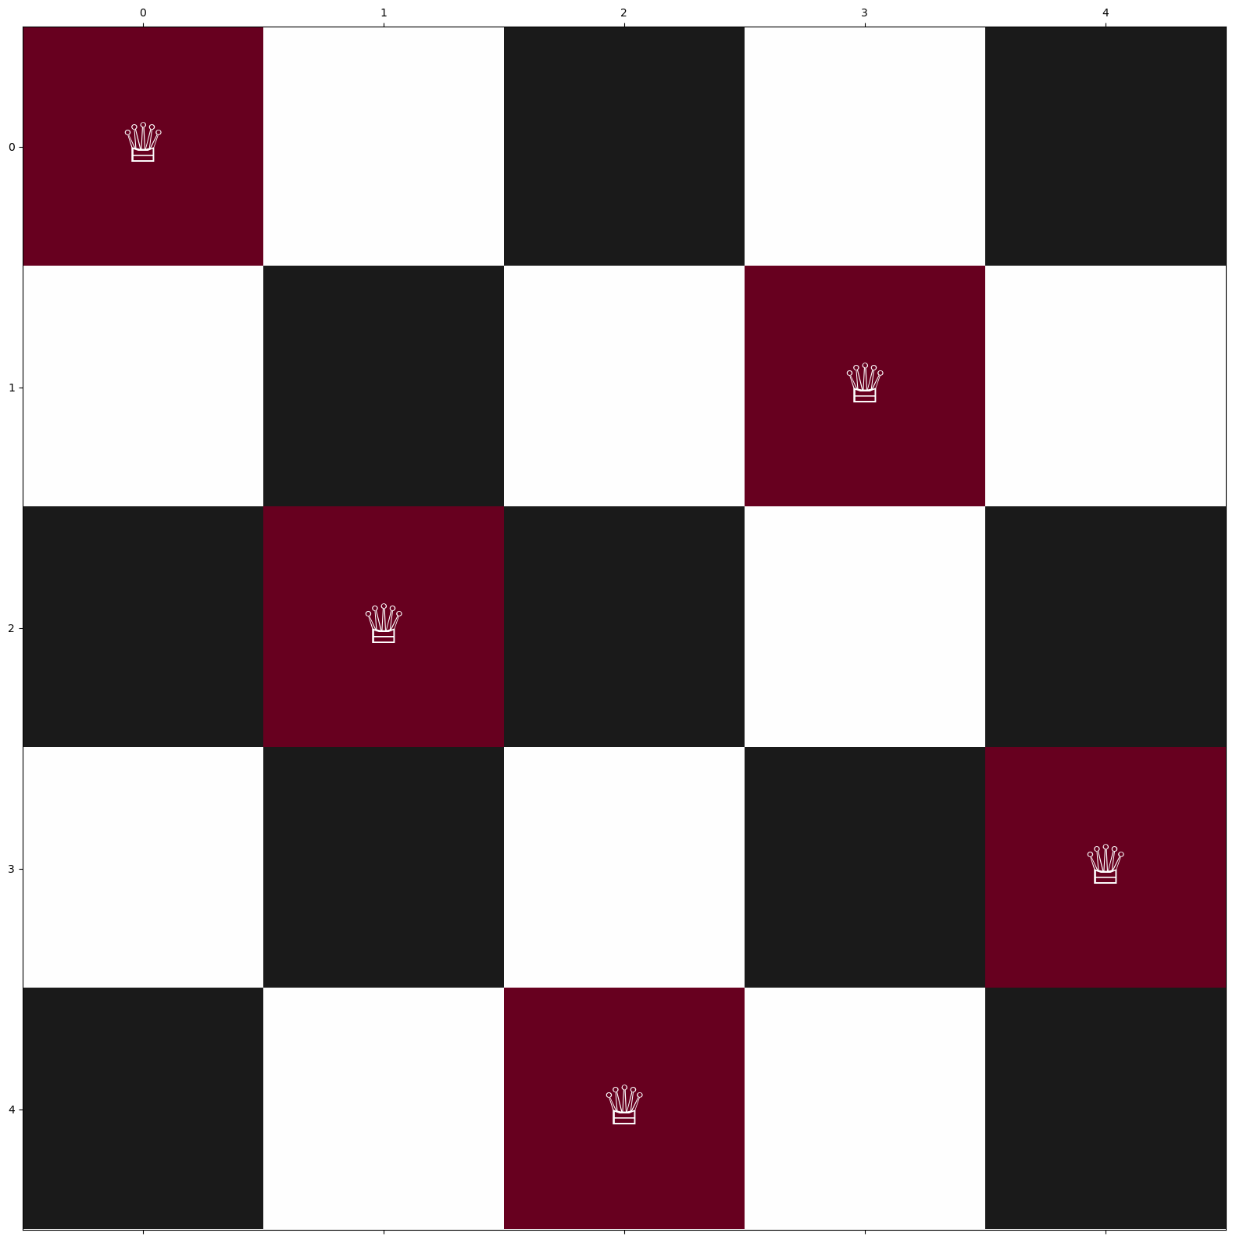
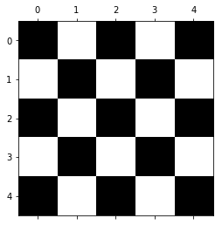
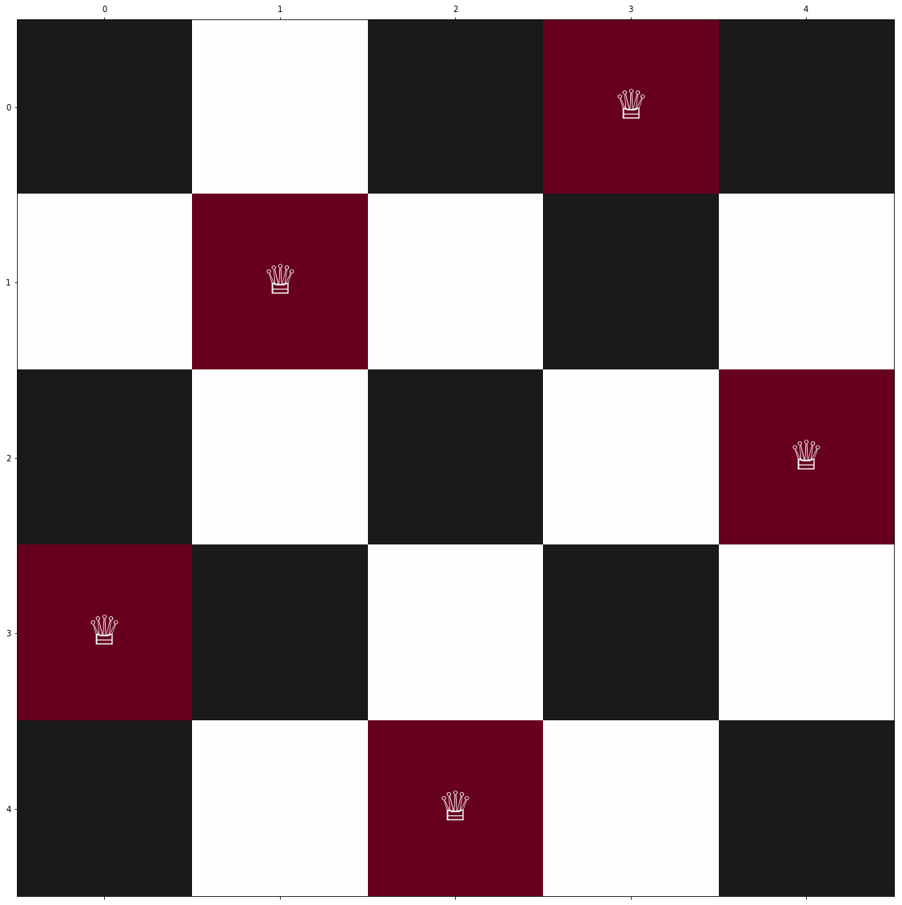
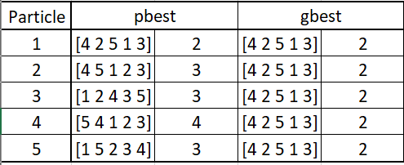
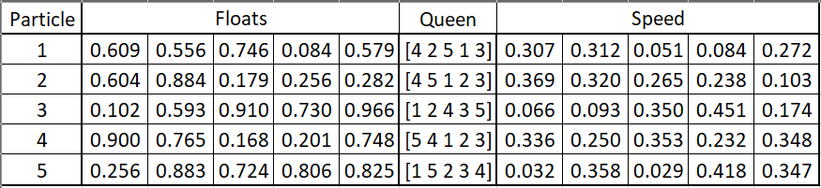
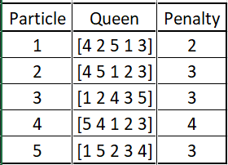
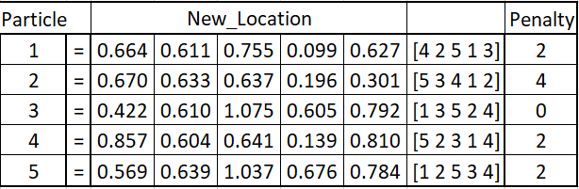
Numerical Example
4. Update Speed, Update Location
2. Calculate the Penalty given by ‘Queen Position’
Generate Initial ‘Position’ and ‘Speed’
3. Update Pbest and Gbest
0
1
2
3
4
N = 5

Slide 12
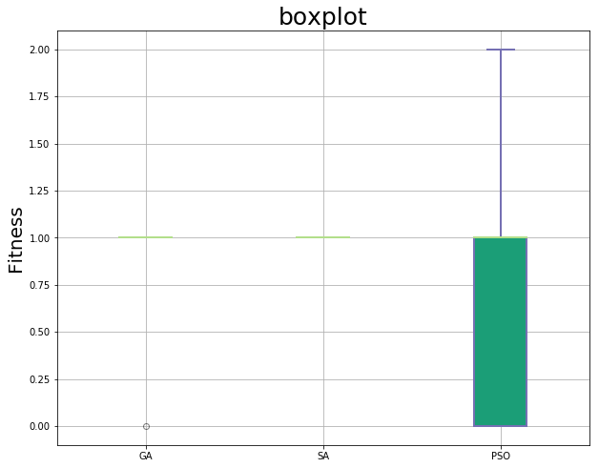
Comparison
GA_20 = [1,0,1,1,1,1,1,1,1,1,1,1,1,1,1,1,1,1,1,1]
SA_20 = [1,1,1,1,1,1,1,1,1,1,1,1,1,1,1,1,1,1,1,1]
PSO_20 = [0,0,0,1,1,1,0,0,0,0,1,1,0,0,1,1,2,2,2,2]
We do the 20 times of 3 algorithm(GA、SA、PSO) and each time have 300 interactions. Although the variance of GA and SA is very small, but the performance of PSO is good .so we choose PSO to be our final algorithm.

Slide 13

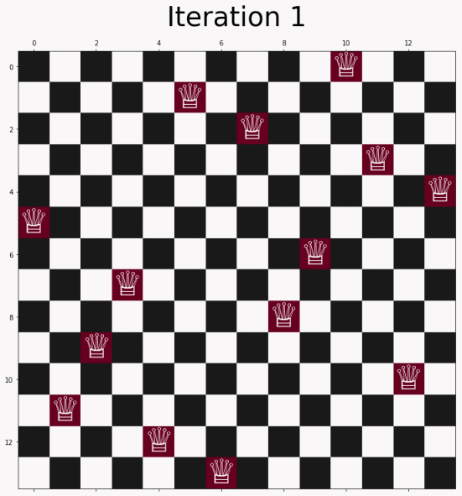
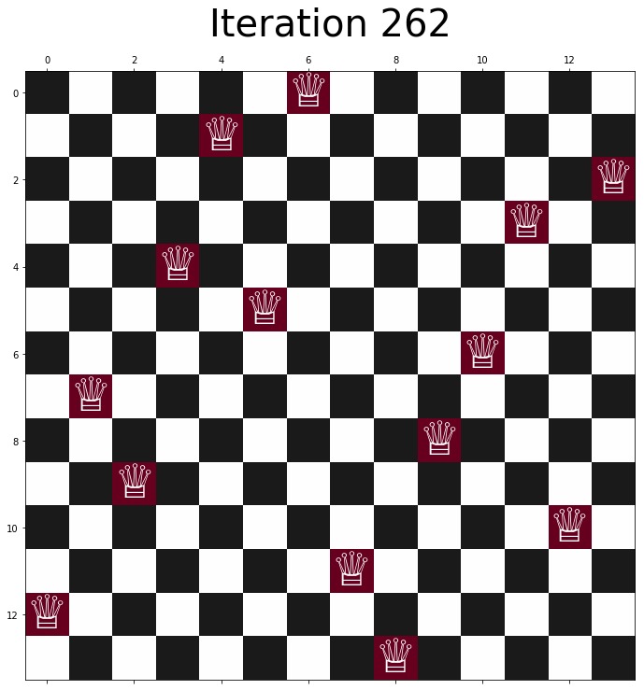
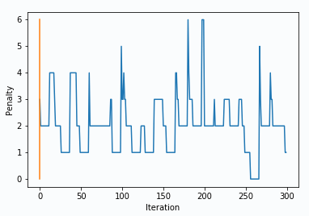
Result

Slide 14
Conclusion
Closing remarks
PSO beats GA & SA when finding solution (n = 14), but with bigger variation
Difficulties encountered
Not easy to find the feasible solution of bigger chessboard
Possible improvements
Split multiple blocks respectively, and recalculate the combination

Slide 15
THANK YOU!
TERIMA KASIH!
謝謝!
Muchas Gracias!

